Slide 1
DAY 14 PPT
DLOPEN,FUNCTION WITHOUT MAIN

Slide 2
dlopen
dlopen is a function provided by Unix-like operating systems, including Linux, that allows a program to load shared libraries dynamically at runtime. This function is part of the dynamic linking mechanism and enables programs to access external code and data defined in shared libraries (.so files) without needing them to be linked at compile time.
Purpose:
Dynamic Loading: dlopen dynamically loads a shared library into the memory of a running process, allowing the program to access the functions and data structures defined in that library.
Behavior:
dlopen loads the specified shared library into the process's address space and returns a handle (a pointer) to the loaded library. This handle is used to refer to the library in subsequent operations.
The shared library is loaded and its symbols are made available to the calling program.
If the library is already loaded, dlopen increments its reference count and returns the handle to the already loaded library.
The library's initialization code (e.g., constructors) may be executed upon loading the library.
Usage: Opening a Shared Library:
void *handle = dlopen("libexample.so", RTLD_LAZY);
This line opens the shared library named "libexample.so" and returns a handle to it. The RTLD_LAZY flag indicates that symbol resolution should be performed lazily, i.e., only when the symbols are referenced.
Accessing Symbols:
Once the shared library is opened, you can access symbols (functions, variables, etc.) defined in it using dlsym function.
Closing the Library:
After using the symbols from the shared library, it's essential to close it to free up resources using dlclose function.

Slide 3
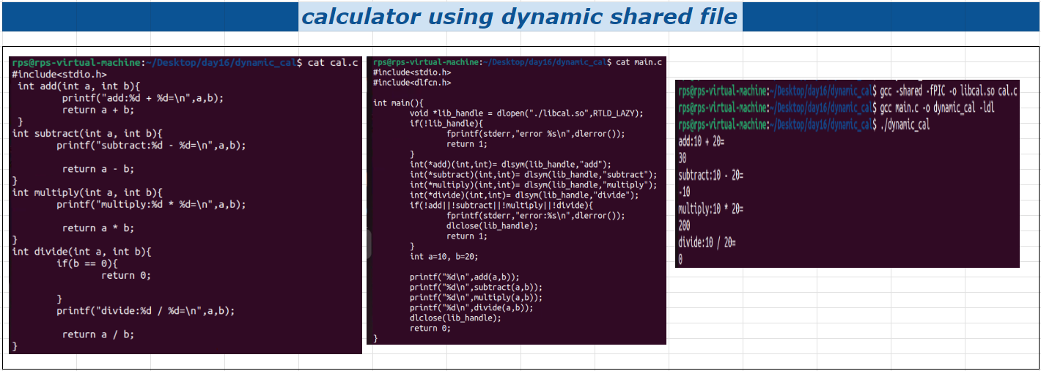
Calculator program using dlopen

Slide 4
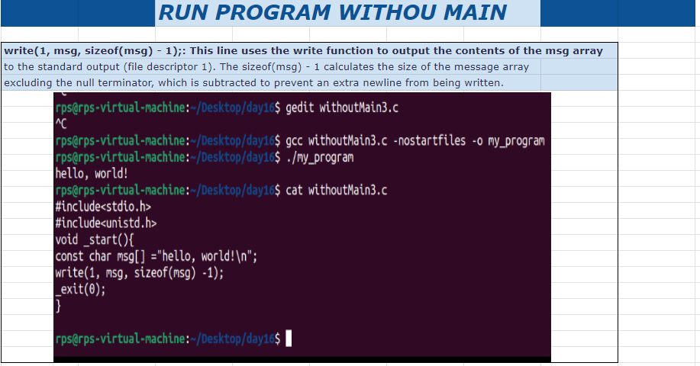
RUNNING PROGRAM WITHOUT MAIN

Slide 5
THANK YOU

